Slide 1
Air-BnB Recommendation System
Group 7
Wong Xin Pei
Candy Lim
Tan Jun Xian

Slide 2
Agenda
Objective
Data
Conclusion
ML Models/
Techniques
What do want to accomplish?
Exploration
Preparation
Objectives met?
Interesting outcomes
TF-IDF
Cosine-Similarity
K-NN
Doc2Vec
PCA
Tensorboard

Slide 3
Objective
Name | Description | Availability
User
Input
To recommend, we need to
Find similarity between user’s input and the listing descriptions

Slide 4
Data-Exploration
Description

Slide 5
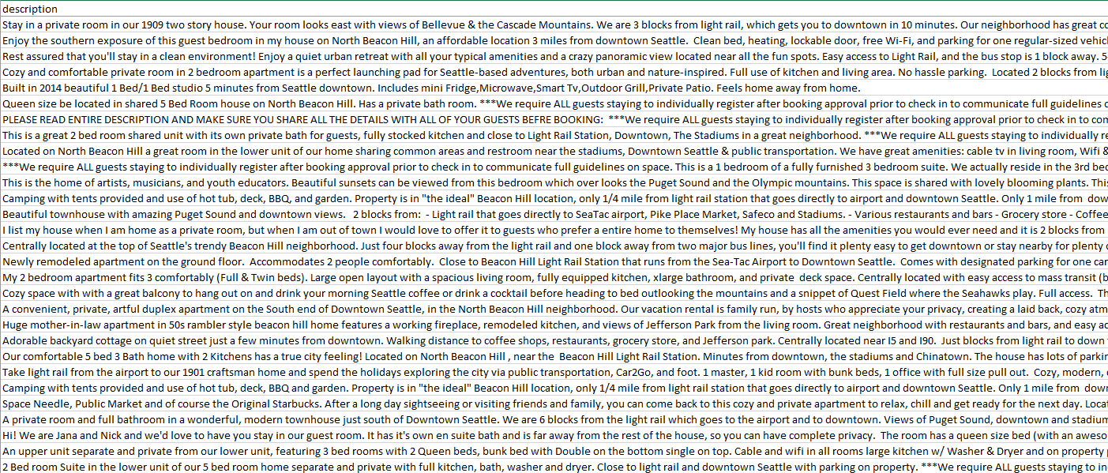
Data-Preparation
Text - Unstructured Data (Description) Column)
Drop all empty rows
Extract out “Description” Column
Remove all non-text data
(Punctuations, Special Char)

Slide 6
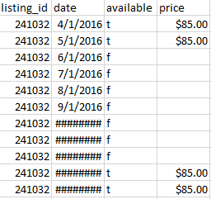
Data-Preparation
Structured Categorical (t/f) Available
Convert t/f to 1/0
Convert to integers

Slide 7
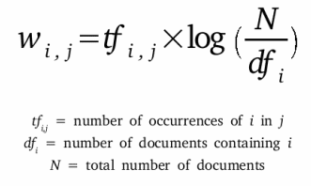
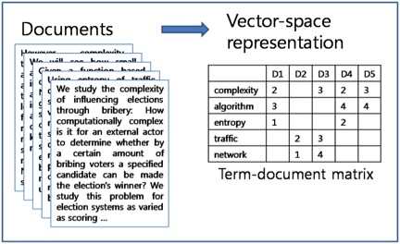
TF-IDF
Term Frequency - Inverse Document Frequency
term = word
Number of times a term (t) appeared in a doc (d)
Total number of docs (d)
*
Total number of docs (n)
Number of documents with the term (t) + 1
Log
Determines how important the word is, in the description
Process of giving a word a numeric value (w)
Vectorize the words/descriptions

Slide 8
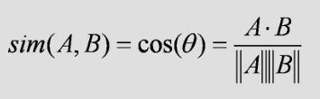
Cosine-Similarity
Determine how similar words/documents are regardless of magnitude
Where A = User’s input, B = Description
Since angle is small,
Similarity value will be high
Exactly same,
Similarity value will be 1
Similarity value will be 0
A
A
A
A
B
B

Slide 9
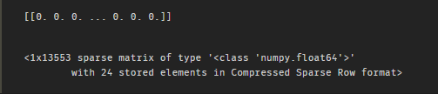
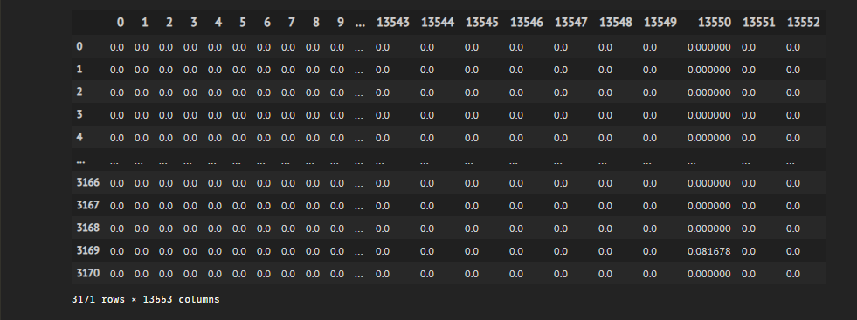
User Input:
I want a big and cozy room and a nice house. It must be near the downtown area for easy access. It must also have an amazing view of the city.
Calculate Cosine Similarity of
User vs Each of every listing

Slide 10
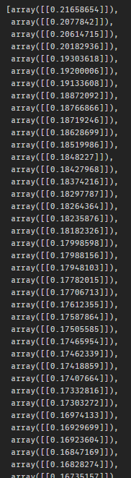
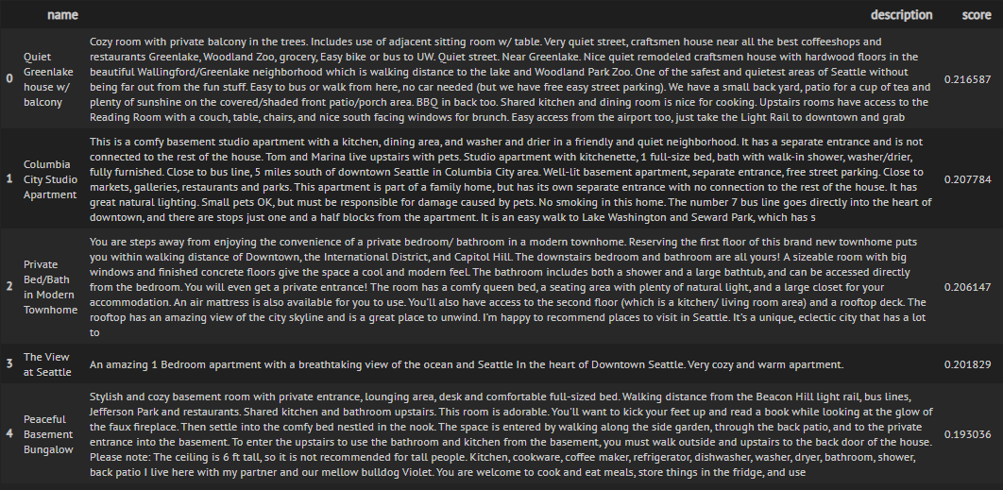
Cosine Similarity Values
User Input:
I want a big and cozy room and a nice house. It must be near the downtown area for easy access. It must also have an amazing view of the city.

Slide 11
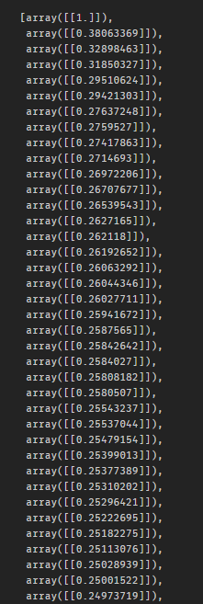
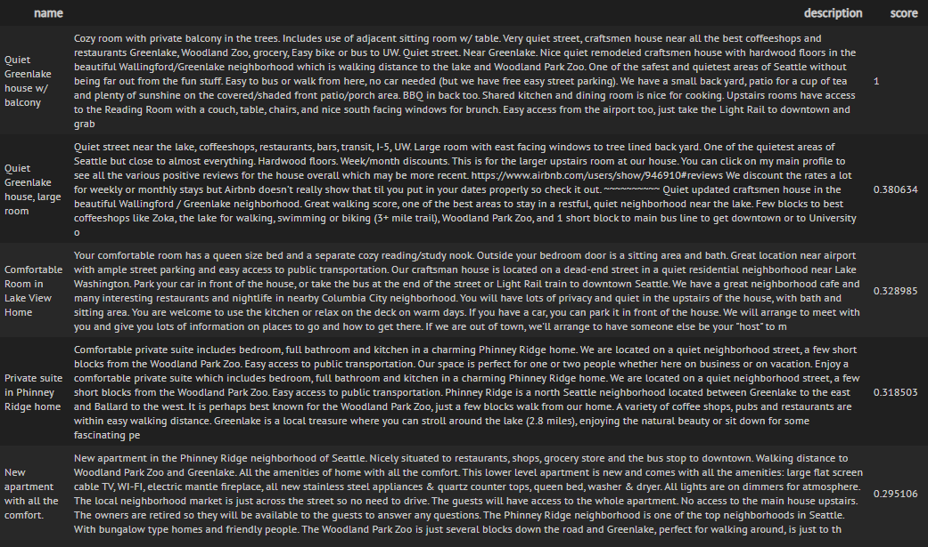
Cosine Similarity Values
User Input:
Cozy room with private balcony in the trees. Includes use of adjacent sitting room w/ table. Very quiet street, craftsmen house near all the best coffeeshops and restaurants Greenlake, Woodland Zoo, grocery, Easy bike or bus to UW. Quiet street. Near Greenlake. Nice quiet remodeled craftsmen house with hardwood floors in the beautiful Wallingford/Greenlake neighborhood which is walking distance to the lake and Woodland Park Zoo. One of the safest and quietest areas of Seattle without being far out from the fun stuff. Easy to bus or walk from here, no car needed (but we have free easy street parking). We have a small back yard, patio for a cup of tea and plenty of sunshine on the covered/shaded front patio/porch area. BBQ in back too. Shared kitchen and dining room is nice for cooking. Upstairs rooms have access to the Reading Room with a couch, table, chairs, and nice south facing windows for brunch. Easy access from the airport too, just take the Light Rail to downtown and grab

Slide 12
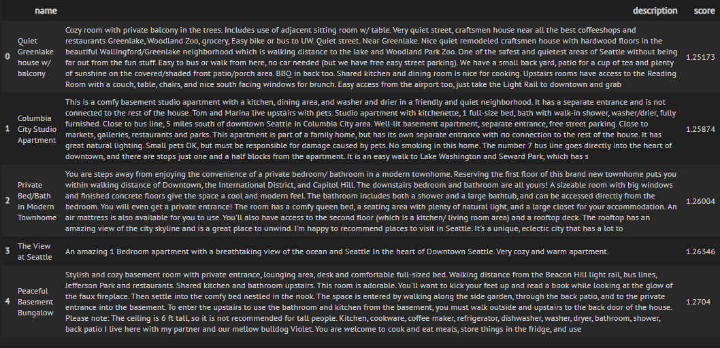
K-NN
Listings are in vector form
Points on graph
Find Nearest Neighbors of “User-Input point” -> Using Euclidean

Slide 13
Doc2Vec (PV-DM)
Word2Vec (Skip-Gram, Window-Size=2)
Simple 2 layer neural network model
Group similar words together
Output
Target
Input
Hidden
0.1
0
1
w1
want
I
0
0.8
1
w2
0
0.1
0
0
w3
0
0
Unique Tag

Slide 14
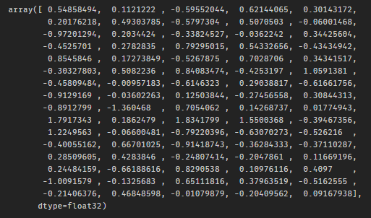
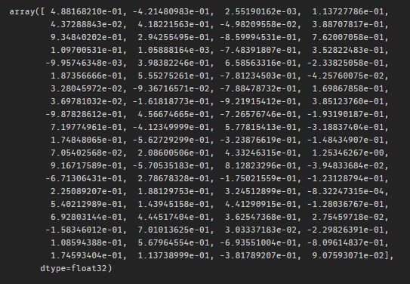
User Input:
I want a big and cozy room and a nice house. It must be near the downtown area for easy access. It must also have an amazing view of the city.
Listing (doc):
Private bedroom with amazing views of DT. Seattle in the heart of downtown. When I am home, I'll sleep on the couch in the living room. The unit is in a very nice, clean, modern bldg. Wifi available. right in the heart of downtown. close to everything you might need. wifi. cable TV. as much as you like. Yes. 4 blocks away from the train stations. should be able to walk to everything too.
Cosine-
Similarity Score: 0.455306
vs

Slide 15
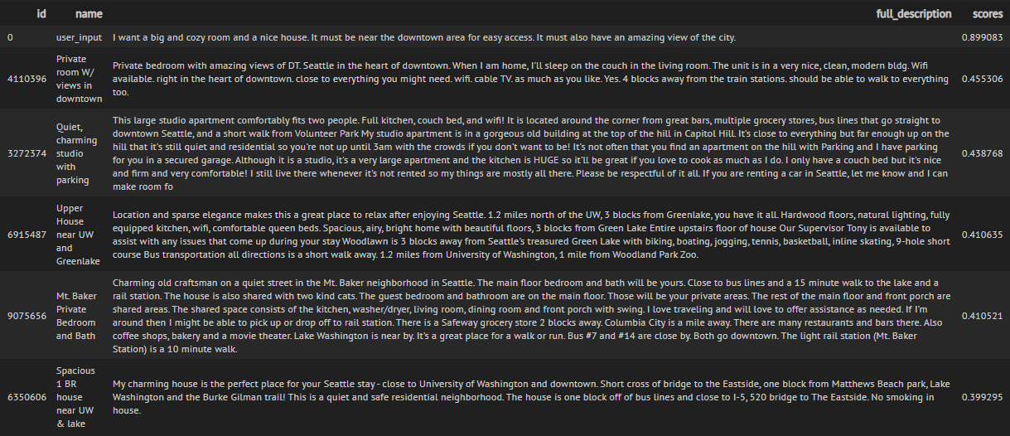
Listing_id used as unique doc_id

Slide 16
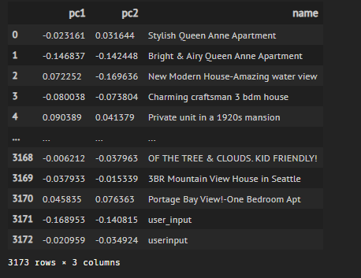
PCA
Principal Component Analysis (Unsupervised)
Dimensionality Reduction Process
Thousands of features/dimensions
2d (pc1, pc2)

Slide 17
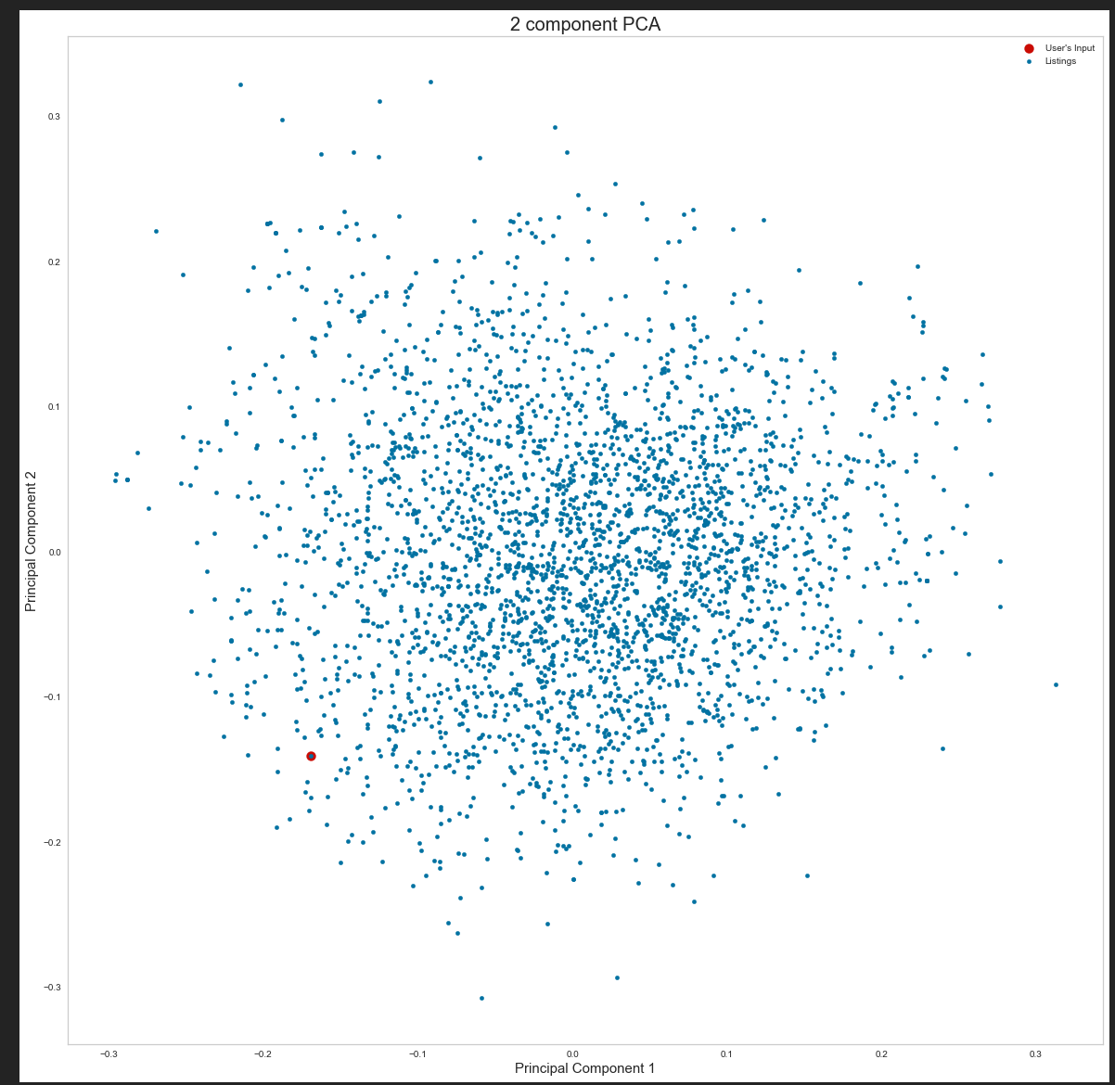
Scatter Plot of the Listings with User’s Input

Slide 18
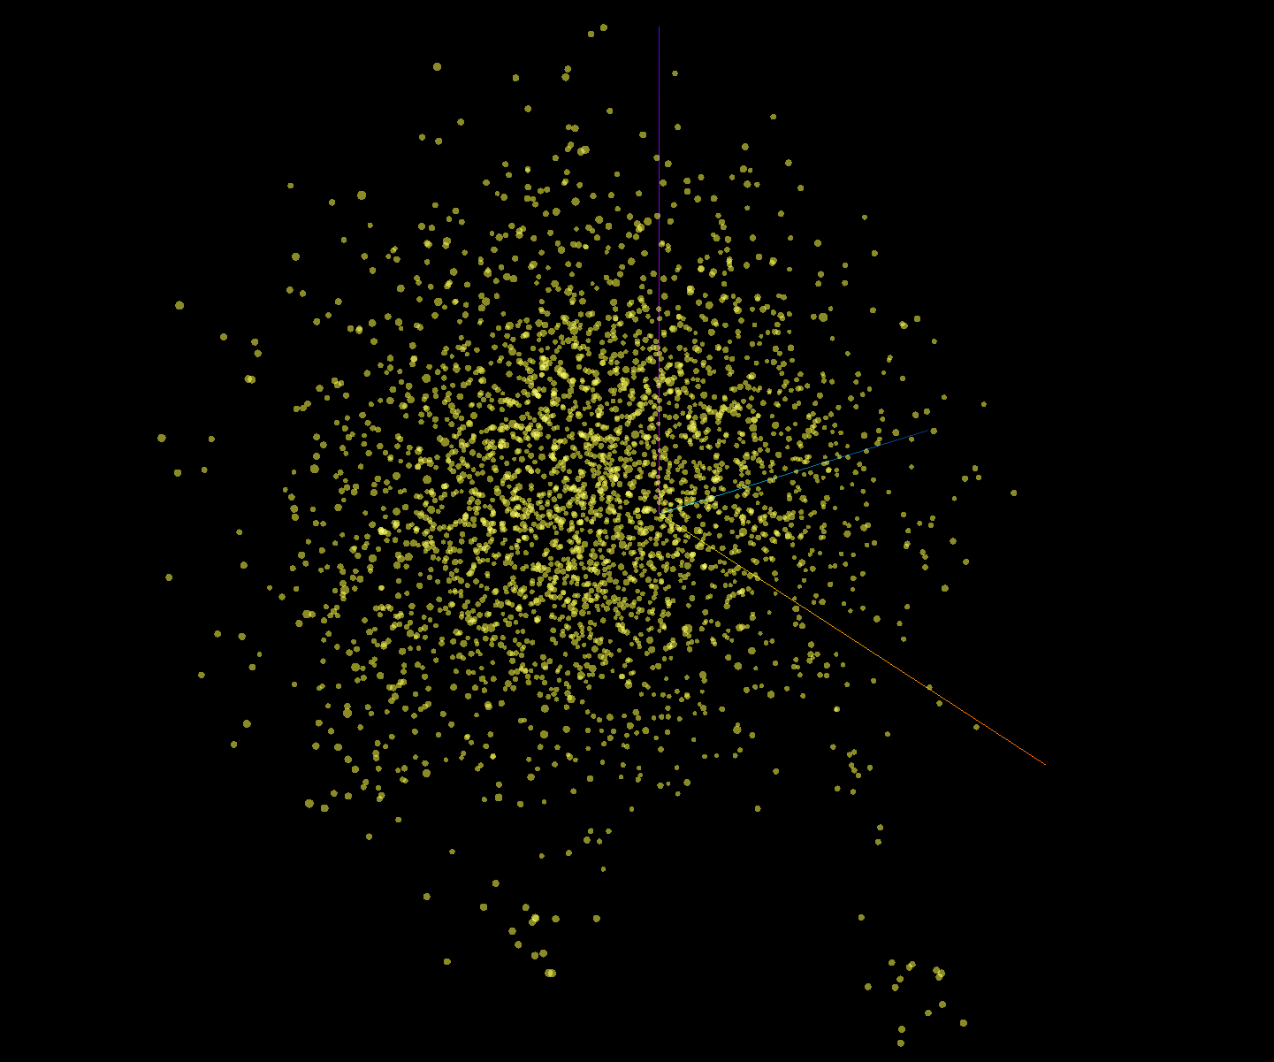
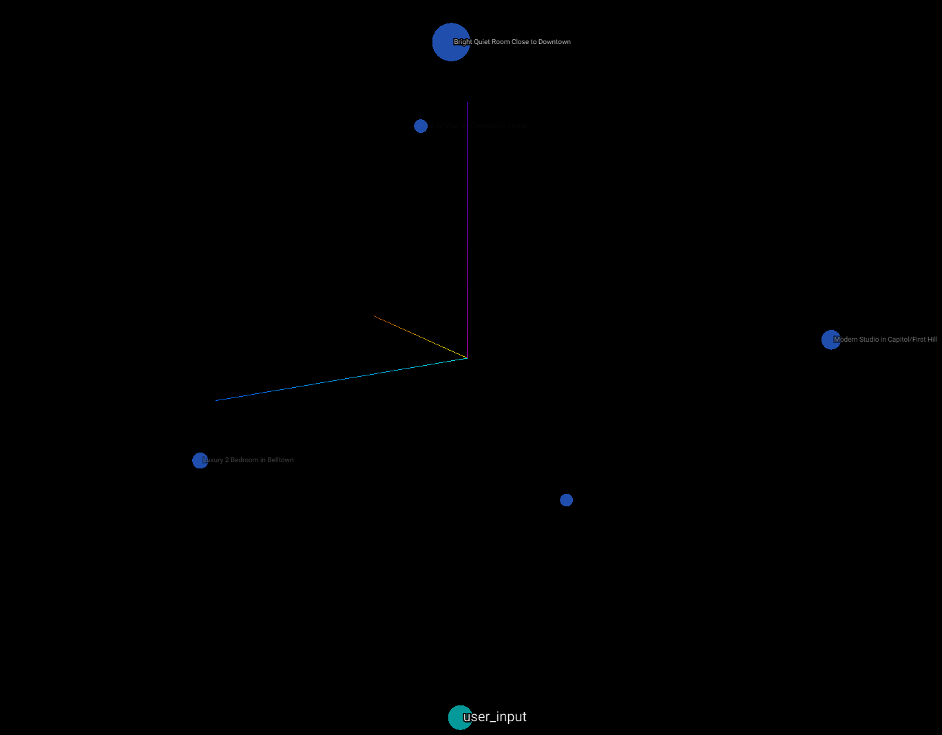
Tensorboard Embedding Projector
Interactive 3D Visualization Tool
After isolating points

Slide 19
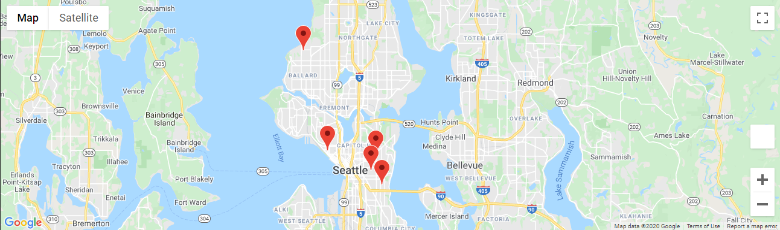
Map location of the Airbnb
System will allow to view listings on google map.

Slide 20
Conclusion
Data
Exploration
Pre-Processing/Cleaning/Filter
Visualization
Able to recommend user an Airbnb room with accuracy
ML Model/Technique
TF-IDF
Cosine-Similarity
K-NN
Doc2Vec
PCA
Tensorboard Projector
Results Visualization
GUI-App
Google Maps

Slide 21
End
Thank you and have a nice day ahead!

